Slide 1
Презентация к уроку английского языка в 8 классе тема урока: Mascots к учебнику Spotlight-8
Module 8
Выполнила: учитель английского языка Пимахова Александра Владимировна
МОАУ «Лицей № 1 г. Орска»

Slide 2
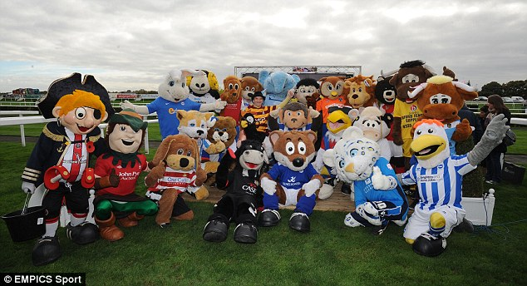
Mascots
The guts and glory, ups and downs .
Both pain and pressure; smiles and frowns.
The bated breaths and angry jeers .
Victorious screams, defeated tears.
It`s sticks and jerseys, mitts and pucks.
The vicious chants, the “REF! YOU SUCK!”s .
It`s overtimes and penalties.
It`s fights and blood and referees.
The mascots, ice girls, rivalries.
The Tandy dropping to his knees.
It`s hours working overtime
To pay your way through ticket-lines.
It`s black and white, yet crystal clear.
It`s hockey. And that`s why we`re here.

Slide 3
What are the mascots?
What do they exist for?
Are you interested in sport?
Do you like to play or to watch?
Are you a supposititious person?
Do you believe that some things can bring good luck?
How often do you watch matches?
Do sportsmen believe in good luck?

Slide 4
My goal for today is:
To learn new words
To learn information about “Mascots”
To ask and answer questions
To make a poster
To present my project
To…

Slide 5
Let‘s read the text “Mascots” page 133.
Let`s learn some more information about the figures , which bring luck to different teams

Slide 6

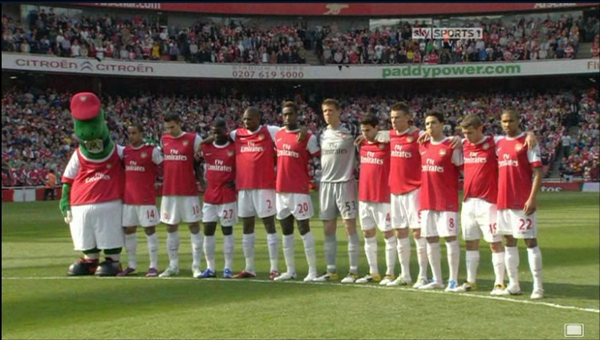
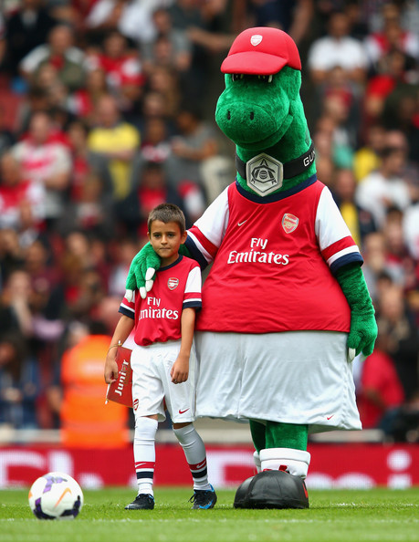
Gunnersaurus Rex

Slide 7
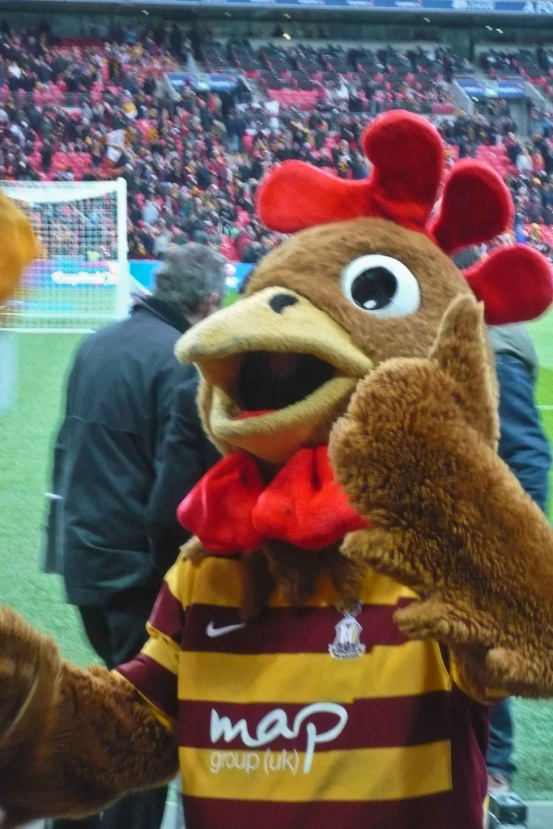

Billy Bantam

Slide 8
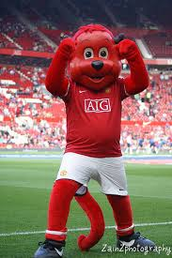
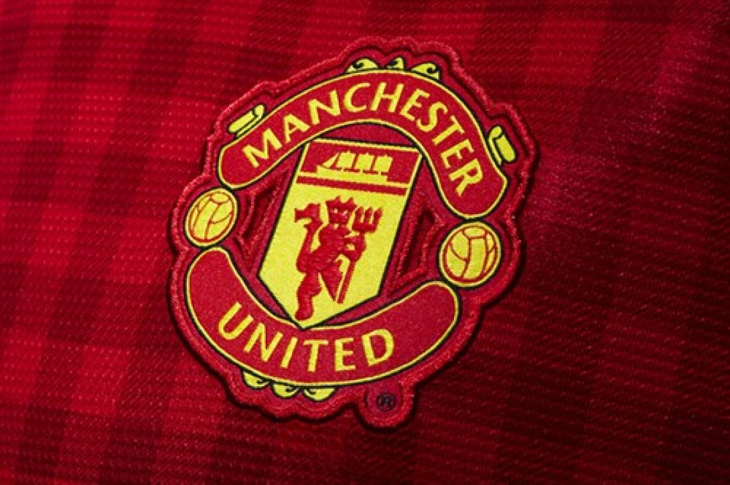
Fred the Red

Slide 9
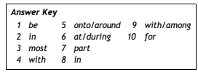
Check your answers

Slide 10
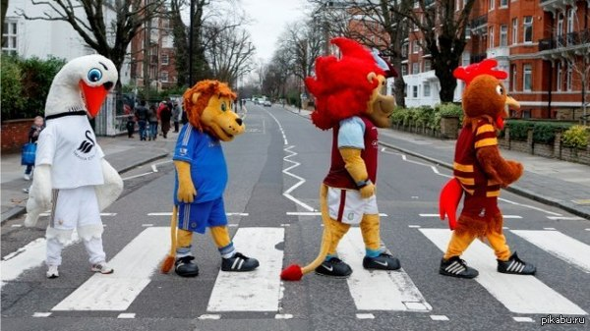
1 cuddly ― soft
2 promote ― encourage
3 represent ― work for
4 respected ― admired
5 wanders ― walks around

Slide 11
What have you learned about football mascots:
1. Which of them has won 13 titles?
2.Which of them takes part in penalty?
3. Which of them abseiled down
the side of the stadium and what for?

Slide 12
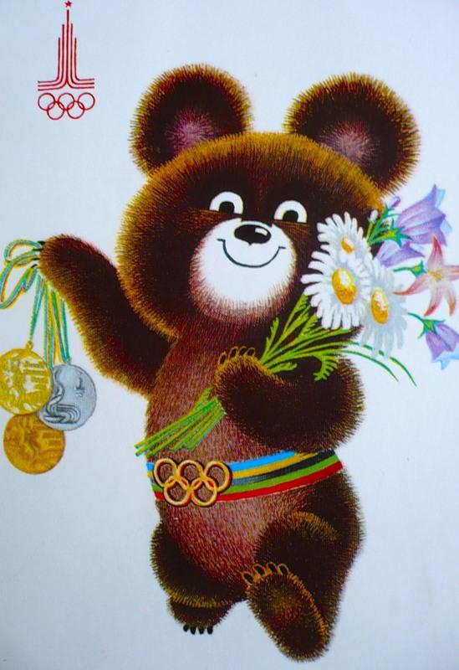
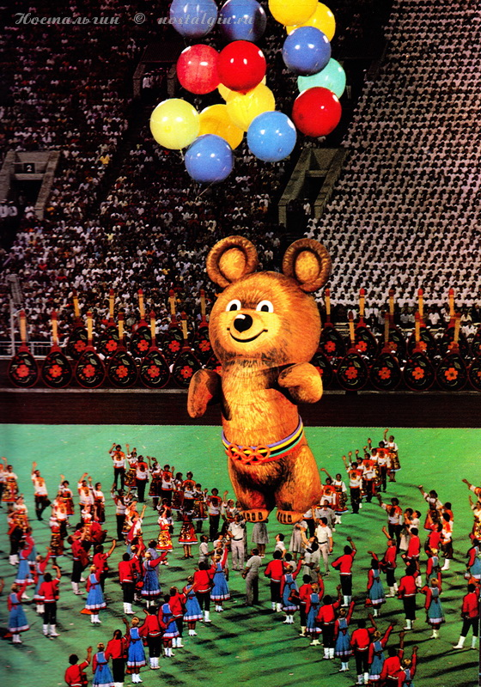
Russian Mascots

Slide 13

Project
Research mascots in your country.
Make a poster showing several ones. Label the pictures with their names and which teams they belong to

Slide 14



Slide 15
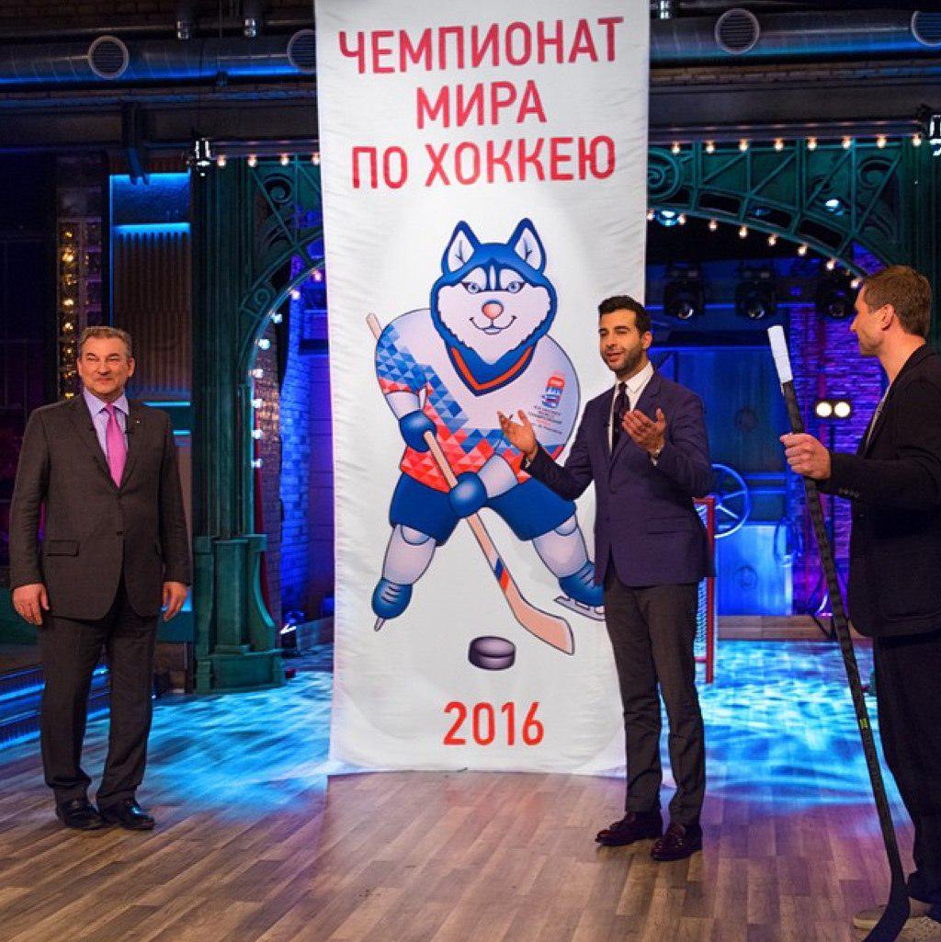
Home task:
Make a poster about mascots of Russian teams

